Slide 1
Myoshi Mitchell
Career Packet

Slide 2
Personal Profile
Hello,
Thank you for viewing my work experience. I have been a performing artist for 25 years and moved on to becoming a digital artist specializing in Social Media content, Marketing, video, photography and website development.
My experience as an artist has afforded me the ability to see from the clients perspective but also a firm understanding of how to translate their vision onto various multimedia platforms.
I am currently creating and hosting my own entertainment platform for true fans of entertainment and Lifestyle Technology.
​
I am a true Jane of All Trades Mastering Everyone!

Slide 3
Inspiration
My inspiration comes from being a New Yorker and a performing artist. I wanted my personal brand to display some one who is Edgy, Fun, Sophisticated, and confident.

Slide 4
Resume Font : Oswald, Lato

Slide 5
Letterhead Font: Glacial indifference

Slide 6
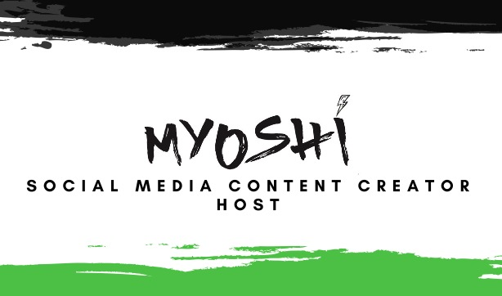

Font: Glacial Indifference Allura
Business Card

Slide 7
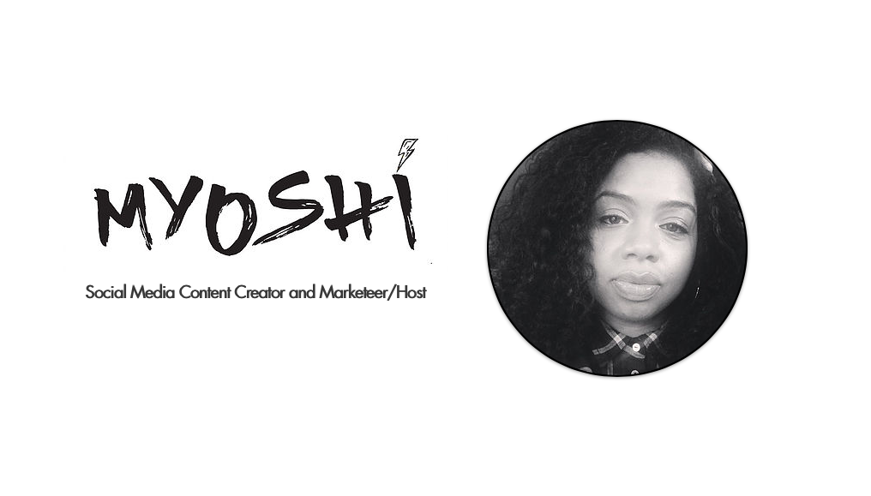
Resume Website Mock Up
Font: Futura, MonoType Bakersfield

Slide 8
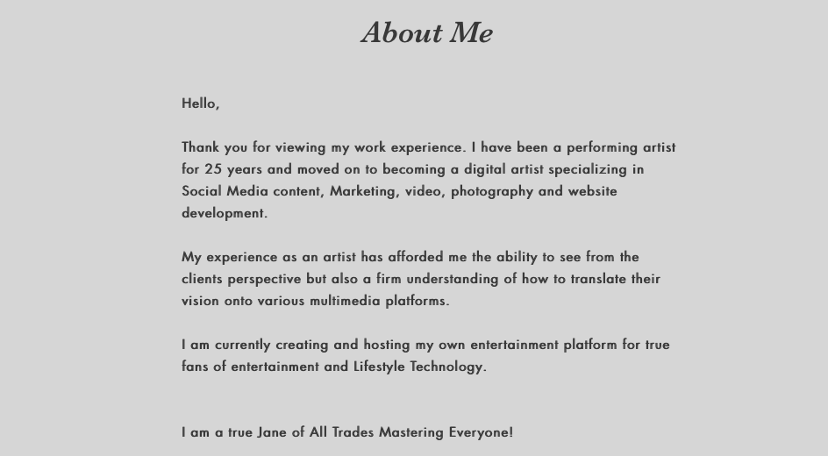

Slide 9
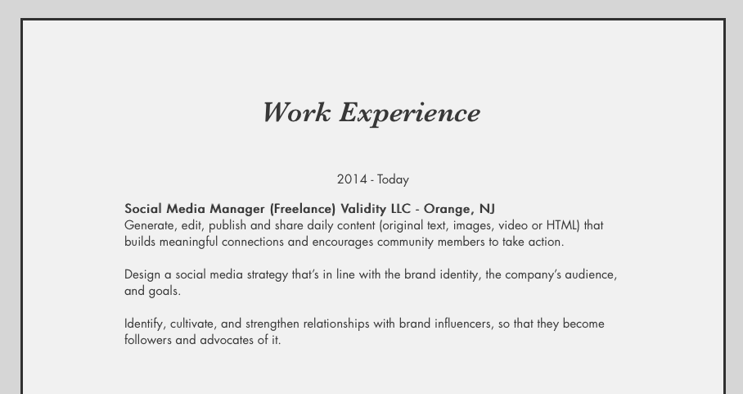

Slide 10
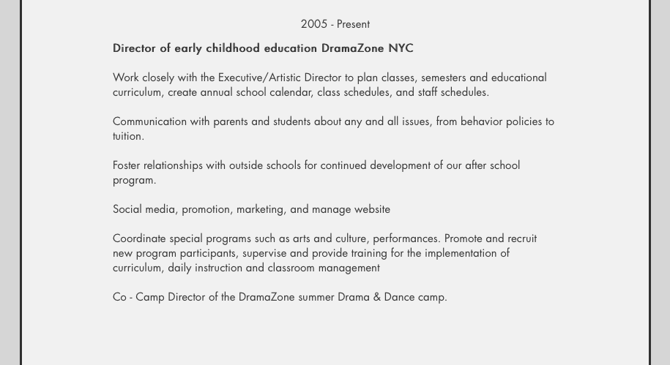

Slide 11
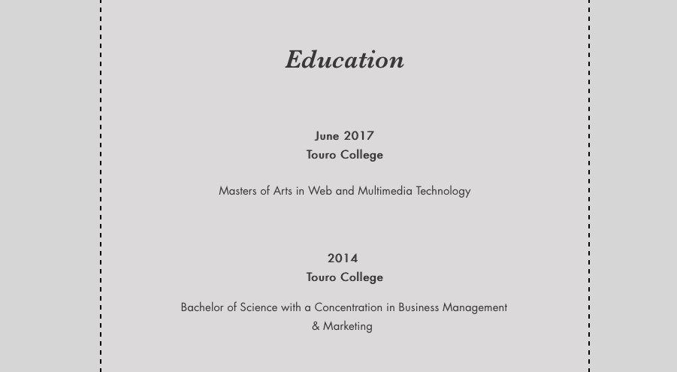

Slide 12
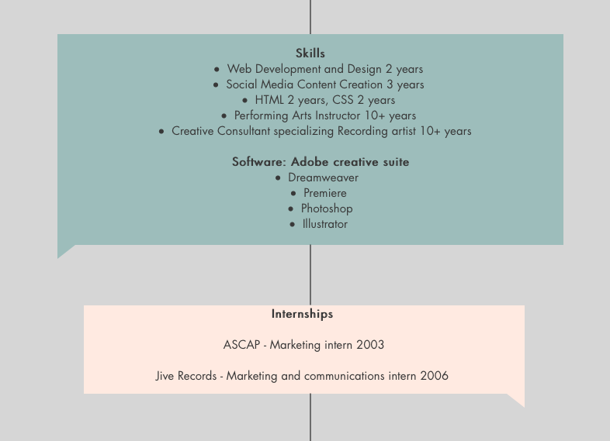

Slide 13
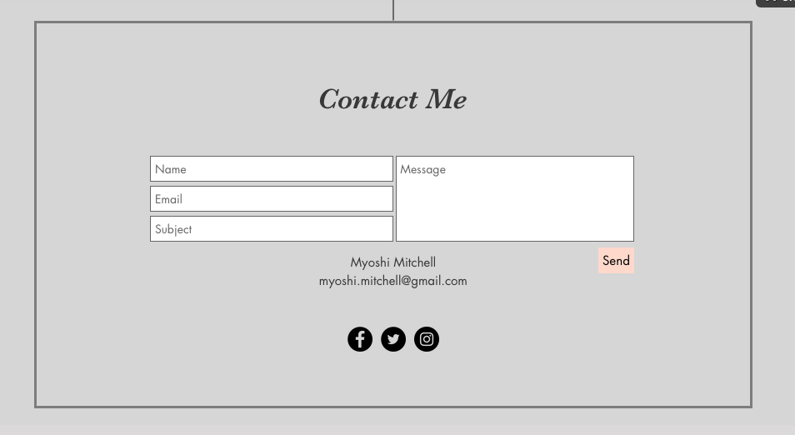

Slide 14
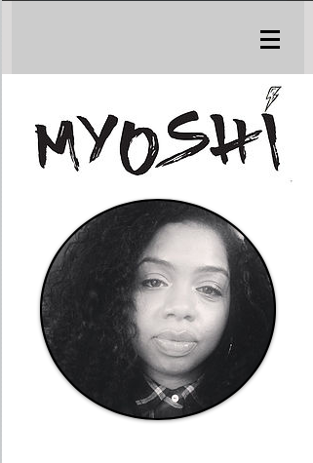
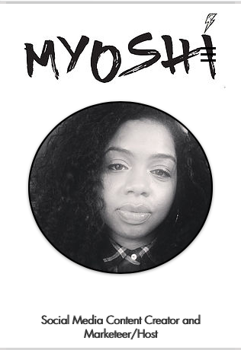
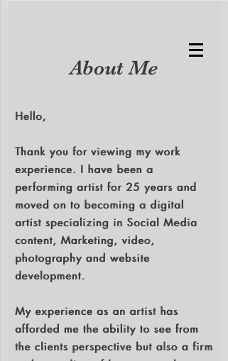

Slide 15
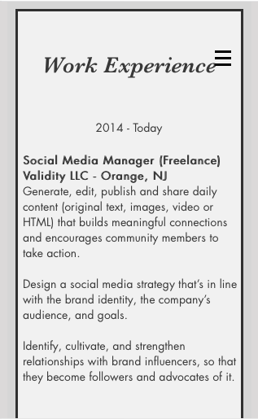
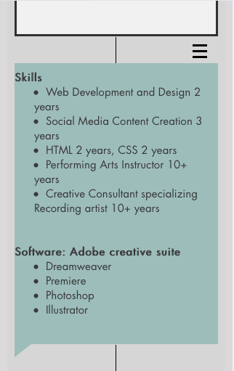
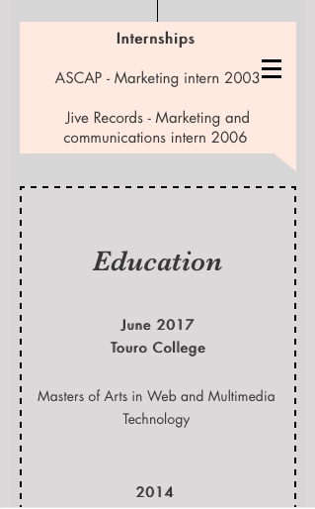

Slide 16
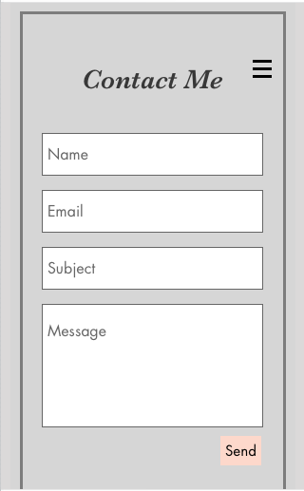

Slide 17
Plans
Freelance – Picking up gigs that will not only help me expand as an artist. But not being tied down to a company will benefit my lifestyle.
Entrepreneurship – Creating a company that guides it’s clients to showcase their online presence organically, effectively, and creatively.

Slide 18
Thank You

